Slide 1
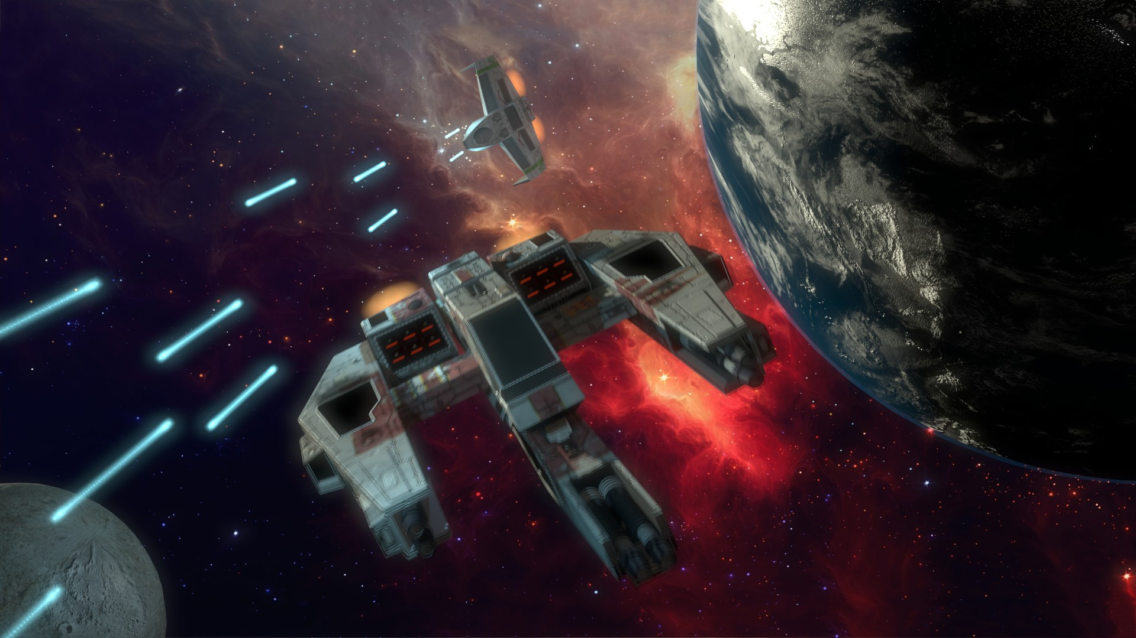
Main
Pilots
Ships
Cannons
Missiles
Load Simulation

Slide 2
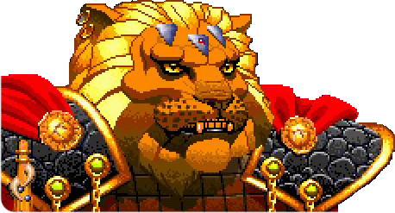
Kilrathi Pilots
Pilots
Ships
Cannons
Missiles
Load Simulation
Load Confederation Pilots
Prince Thrakath nar Kiranka
Bakhtoh “Redclaw’ nar Kiranka
Bhurak “Starkiller” nar Sihkag
Dakhath nar Caxki
Khajja nar ‘Ja’Targk
Ja’Trosh “Long Fang” nar Caxkai
First Tooth
Primary Fang
Prince Thrakath nar Kiranka
Cost:
195
Pilot Skill
Gunnery Skill
Psych
Pilot Ability:
8
9
9
If Prince Thrakath is deployed, he is automatically the Wing Leader. If there is more then one wing, he automatically the Squadron Commander. His wing members do not test for stress if they are outnumbers at the beginning of the game. Thrakath himself may re-roll any failed gunnery tests he suffers. he may re-roll a single failed dodge test per game turn.

Slide 3

Pilots
Ships
Cannons
Missiles
Load Simulation
Load Confederation Pilots
Prince Thrakath nar Kiranka
Bakhtoh “Redclaw’ nar Kiranka
Bhurak “Starkiller” nar Sihkag
Dakhath nar Caxki
Khajja nar ‘Ja’Targk
Ja’Trosh “Long Fang” nar Caxkai
First Tooth
Primary Fang
Bakhtosh 'Redclaw' nar Kiranka
Cost:
210
Pilot Skill
Gunnery Skill
Psych
Pilot Ability:
8
9
9
Redclaw may re-roll any failed gunnery skill tests he suffers.

Slide 4
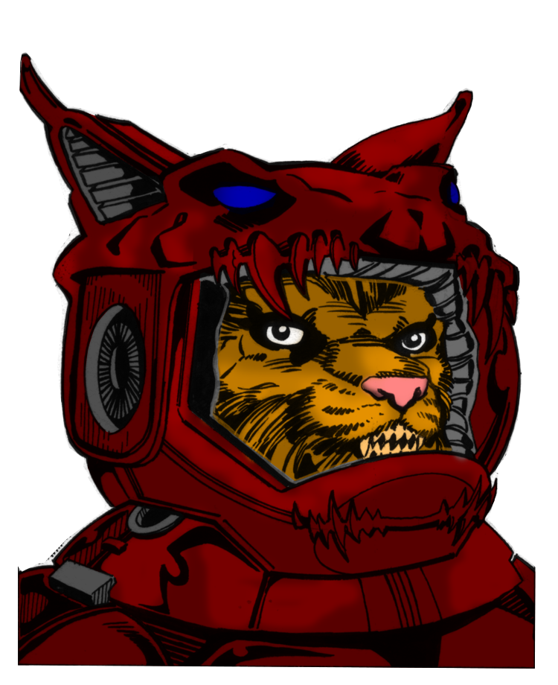
Pilots
Ships
Cannons
Missiles
Load Simulation
Load Confederation Pilots
Prince Thrakath nar Kiranka
Bakhtoh “Redclaw’ nar Kiranka
Bhurak “Starkiller” nar Sihkag
Dakhath nar Caxki
Khajja nar ‘Ja’Targk
Ja’Trosh “Long Fang” nar Caxkai
First Tooth
Primary Fang
Bhurak 'Starkiller' nar Caxki
Cost:
110
Pilot Skill
Gunnery Skill
Psych
Pilot Ability:
7
8
7
Bhurak dislikes using missiles, feeling that are beneath his skills. If he used a missile type weapon, and the attack is dodged, Bhurak must take a psych test. If he fails he gains 1 stress token.

Slide 5
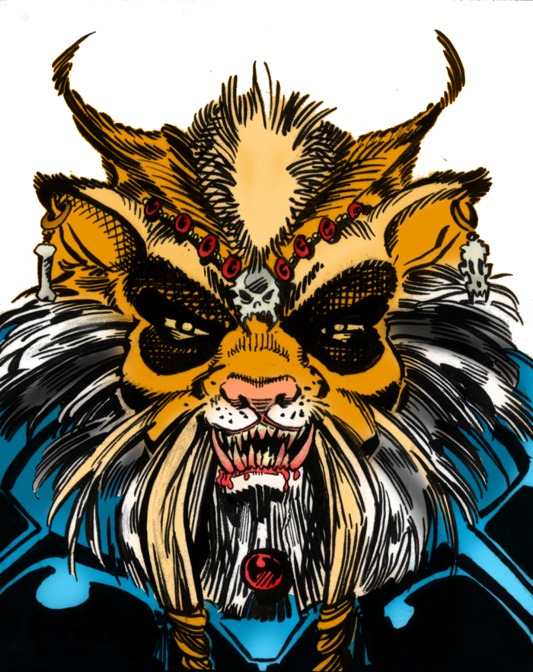
Pilots
Ships
Cannons
Missiles
Load Simulation
Load Confederation Pilots
Prince Thrakath nar Kiranka
Bakhtoh “Redclaw’ nar Kiranka
Bhurak “Starkiller” nar Sihkag
Dakhath nar Caxki
Khajja nar ‘Ja’Targk
Ja’Trosh “Long Fang” nar Caxkai
First Tooth
Primary Fang
Dakhat nar Sihkag
Cost:
125
Pilot Skill
Gunnery Skill
Psych
Pilot Ability:
7
8
7
Dakhath is exceptionally viscious but also loves a good dog fight. If he attempts to taunt an enemy pilot, count his psych stat as being 8. If Dakhath is the Wing Leader and his wing is outnumbers at the beginning of the game, his wing mates do not test to see if they are concerned. They are looking forward to a good fight.

Slide 6
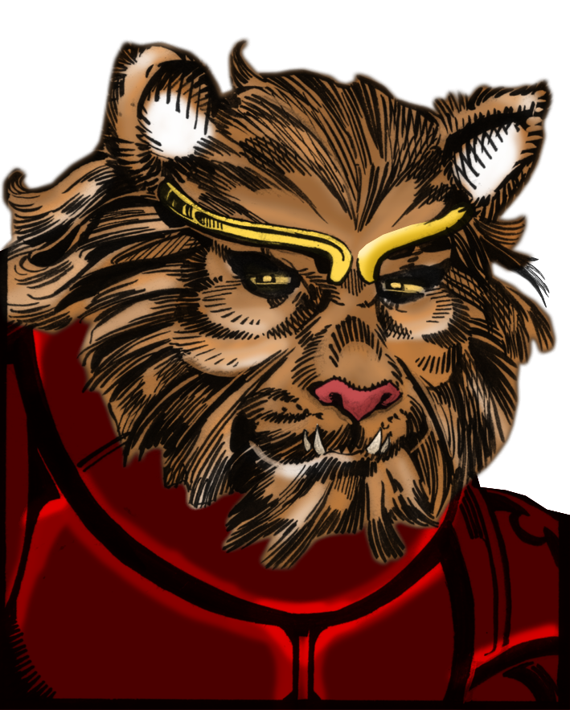
Pilots
Ships
Cannons
Missiles
Load Simulation
Load Confederation Pilots
Prince Thrakath nar Kiranka
Bakhtoh “Redclaw’ nar Kiranka
Bhurak “Starkiller” nar Sihkag
Dakhath nar Caxki
Khajja nar ‘Ja’Targk
Ja’Trosh “Long Fang” nar Caxkai
First Tooth
Primary Fang
Khajja nar Ja'targk
Cost:
230
Pilot Skill
Gunnery Skill
Psych
Pilot Ability:
8
8
7
Khajja is exceptionally single minded in his tactics. When testing to resist a taunt, treat his ego stat as being 8 rather then 5

Slide 7
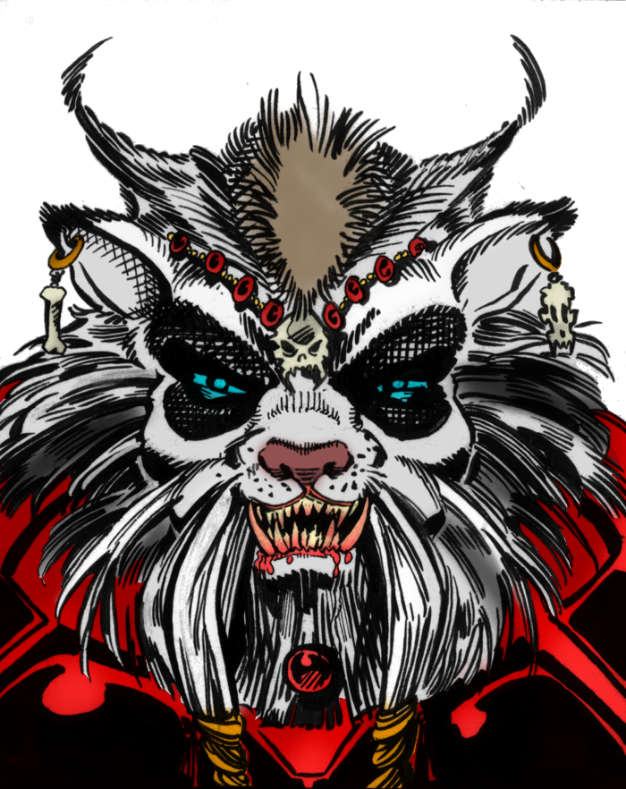
Pilots
Ships
Cannons
Missiles
Load Simulation
Load Confederation Pilots
Prince Thrakath nar Kiranka
Bakhtoh “Redclaw’ nar Kiranka
Bhurak “Starkiller” nar Sihkag
Dakhath nar Caxki
Khajja nar ‘Ja’Targk
Ja’Trosh “Long Fang” nar Caxkai
First Tooth
Primary Fang
Ja’Trosh ‘Lone Fang’ nar Caxkal
Cost:
195
Pilot Skill
Gunnery Skill
Psych
Pilot Ability:
8
9
9
Ja’Trosh is a loner by nature and prefers to fight on his own. He is unaffected by abilities that modify his psych stat, both enemy and friendly. He can re-roll failed pilot skill tests. If he is alone, count his Psych stat as 7 rather then 6.

Slide 8
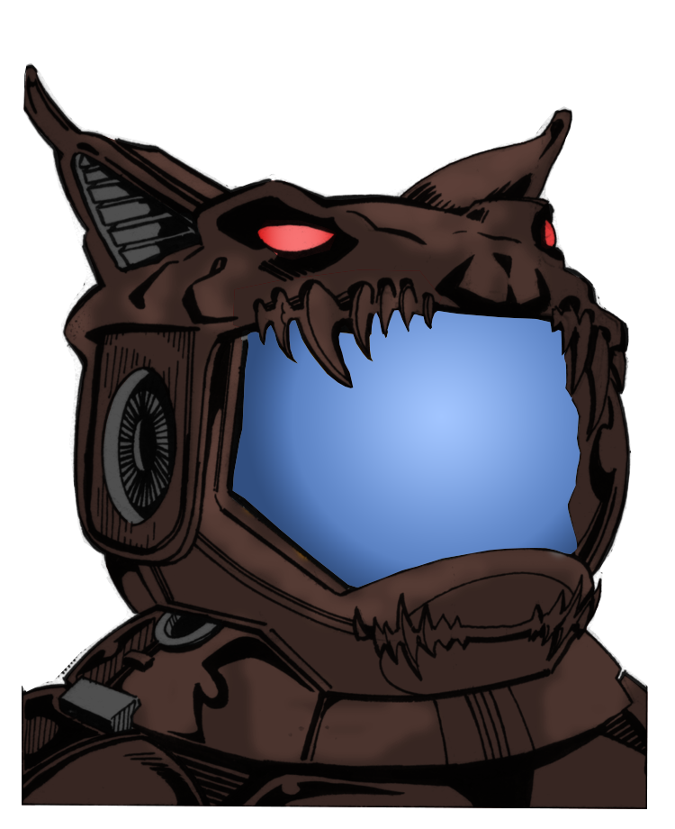
Pilots
Ships
Cannons
Missiles
Load Simulation
Load Confederation Pilots
Prince Thrakath nar Kiranka
Bakhtoh “Redclaw’ nar Kiranka
Bhurak “Starkiller” nar Sihkag
Dakhath nar Caxki
Khajja nar ‘Ja’Targk
Ja’Trosh “Long Fang” nar Caxkai
First Tooth
Primary Fang
Primary Fang
Cost:
195
Pilot Skill
Gunnery Skill
Psych
Pilot Ability:
8
9
9

Slide 9
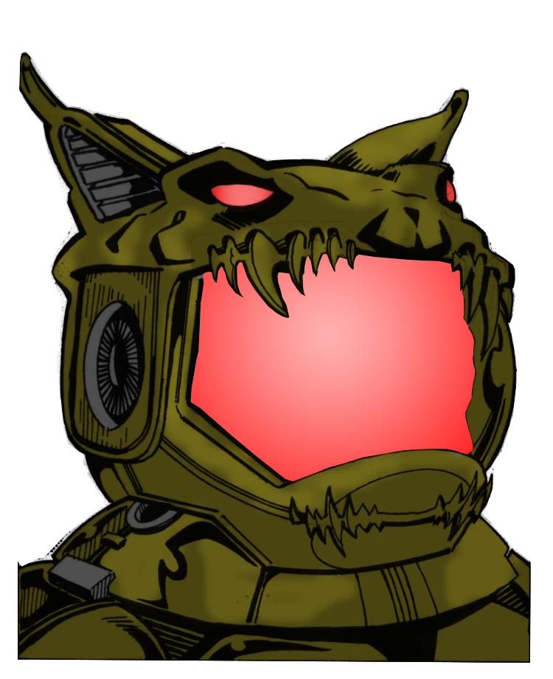
Pilots
Ships
Cannons
Missiles
Load Simulation
Load Confederation Pilots
Prince Thrakath nar Kiranka
Bakhtoh “Redclaw’ nar Kiranka
Bhurak “Starkiller” nar Sihkag
Dakhath nar Caxki
Khajja nar ‘Ja’Targk
Ja’Trosh “Long Fang” nar Caxkai
First Tooth
Primary Fang
First Tooth
Cost:
45
Pilot Skill
Gunnery Skill
Psych
Pilot Ability:
3
2
4

Slide 10
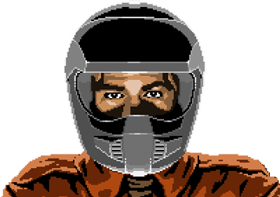
Confed Pilots
Pilots
Ships
Cannons
Missiles
Load Simulation
Load Kilrathi Pilots
Rookie Pilot Confederation Lieutenant
Seether
Troy 'Cathscratch' Carter
Winston 'Vagabond' Chang
Rookie Pilot
Cost:
45
Pilot Skill
Gunnery Skill
Psych
Pilot Ability:
3
2
4

Slide 11
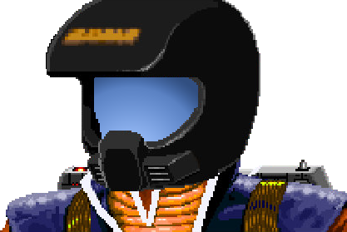
Pilots
Ships
Cannons
Missiles
Load Simulation
Load Kilrathi Pilots
Rookie Pilot Confederation Lieutenant
Seether
Troy 'Cathscratch' Carter
Winston 'Vagabond' Chang
Confederation Lieutenant
Cost:
65
Pilot Skill
Gunnery Skill
Psych
Pilot Ability:
5
3
5

Slide 12
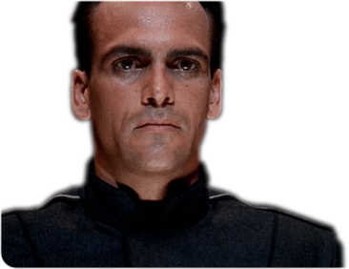
Pilots
Ships
Cannons
Missiles
Load Simulation
Load Kilrathi Pilots
Rookie Pilot Confederation Lieutenant
Seether
Troy 'Cathscratch' Carter
Winston 'Vagabond' Chang
Seether
Cost:
210
Pilot Skill
Gunnery Skill
Psych
Pilot Ability:
9
8
9
When he makes a dodge test, Seether only ever suffers a -1 to his pilot skill. He may re-roll a failed taunt and any failed gunnery skill tests he is called on to make.

Slide 13
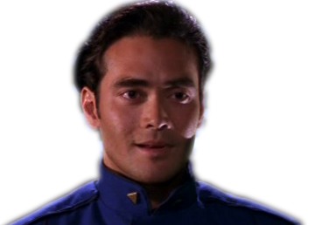
Pilots
Ships
Cannons
Missiles
Load Simulation
Load Kilrathi Pilots
Rookie Pilot Confederation Lieutenant
Seether
Troy 'Cathscratch' Carter
Winston 'Vagabond' Chang
Troy 'Cathscratch' Carter
Cost:
100
Pilot Skill
Gunnery Skill
Psych
Pilot Ability:
5
4
4
If Catscratch fails a Psych test, and the Wing leader/Commander is in his foward arc, he may re-roll the ego test but counts his Ego stat as being 5 rather then 4.

Slide 14

Pilots
Ships
Cannons
Missiles
Load Simulation
Load Kilrathi Pilots
Rookie Pilot Confederation Lieutenant
Seether
Troy 'Cathscratch' Carter
Winston 'Vagabond' Chang
Winston 'Vagabond' Chang
Cost:
190
Pilot Skill
Gunnery Skill
Psych
Pilot Ability:
5
7
7
If Winston Chang is the Wing Leader, all pilots in his wing may re-roll failed psych stat tests. If a friendly pilot with 1 or more stress tokens is with in his forward arc, Chang may attempt to calm them down. To do this he must sacrafice any attacks this turn and pass a psych test. If he succeds, the friendly pilot removes 1 stress token.

Slide 15
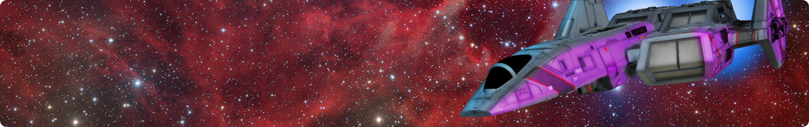
Confed Ships
Pilots
Ships
Cannons
Missiles
Load Simulation
Load Kilrathi Ships
F-103A Excalibur
FA-36A Hornet
HF-66A Thunderbolt VII
F-86C Hellcat V Assault Fighter
F-103A Excalibur
E:
B:
D/4
Cost:
470
7
T:
9
S:
25
H:
11
Ship Ability: The F-103A Excalibur conveys a +1 bonus to all Gunnery skill checks the pilot is called on to make. You may re-roll the first ‘miss’ result you get each turn.
Weapons:
4 – Tachyon Cannons
3 x 4 Missiles

Slide 16
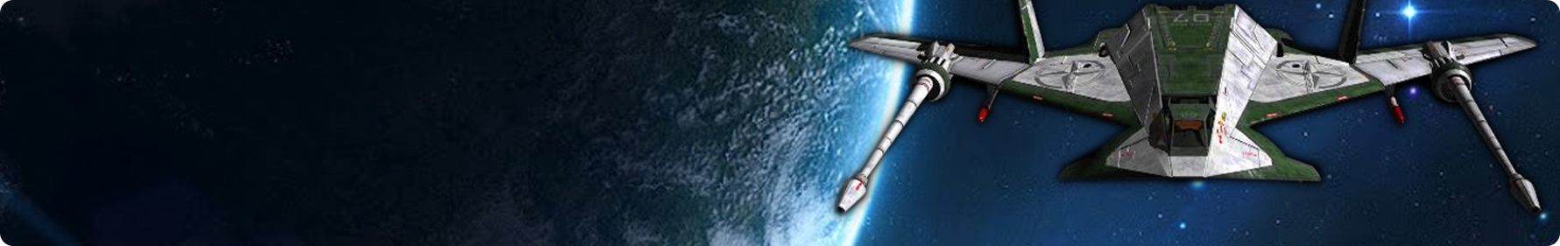
Pilots
Ships
Cannons
Missiles
Load Simulation
Load Kilrathi Ships
F-103A Excalibur
FA-36A Hornet
HF-66A Thunderbolt VII
F-86C Hellcat V Assault Fighter
FA-36A Hornet
B:
E:
F/4
Cost:
110
9
T:
4
S:
3
H:
3
Ship Ability: The Hornet is exceptionally fast for a craft of its era. If converting ‘turn’ to ‘burn’ convert at a rate of 1 inch of movement per 1 degree of turn rather then the normal 1:2.
Weapons:
2 – Laser Cannons
2 x 1 Missiles

Slide 17
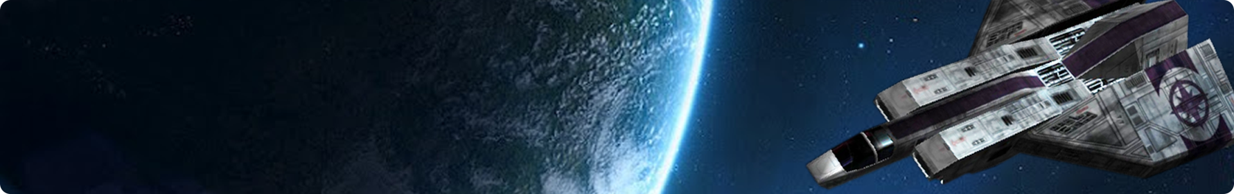
Pilots
Ships
Cannons
Missiles
Load Simulation
Load Kilrathi Ships
F-103A Excalibur
FA-36A Hornet
HF-66A Thunderbolt VII
F-86C Hellcat V Assault Fighter
HF-66A Thunderbolt VII
E:
B:
D/5
Cost:
375
7
T:
5
S:
25
H:
12
Ship Ability: The HF-66A Thunderbolt VII mounts a computer controlled turret that covers its rear quadrant. This weapon fires independently of the main ship allowing it to target a different ship to the pilot. The turret has a Gunnery skill of 4, and mounts a single Mass Driver.
Weapons:
4 – Photon Cannons
2 x 3 Missiles
1 x 1 Torpedoes

Slide 18
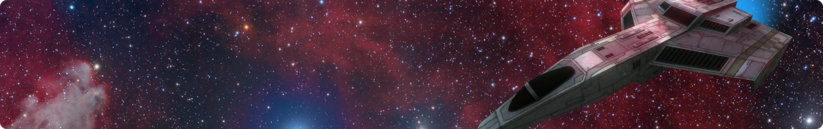
Pilots
Ships
Cannons
Missiles
Load Simulation
Load Kilrathi Ships
F-103A Excalibur
FA-36A Hornet
HF-66A Thunderbolt VII
F-86C Hellcat V Assault Fighter
F-86C Hellcat V Assault Fighter
E:
B:
D/4
Cost:
285
9
T:
6
S:
25
H:
10
Ship Ability: [none]
Weapons:
2 – Neutron Guns
2 x 2 Missiles

Slide 19
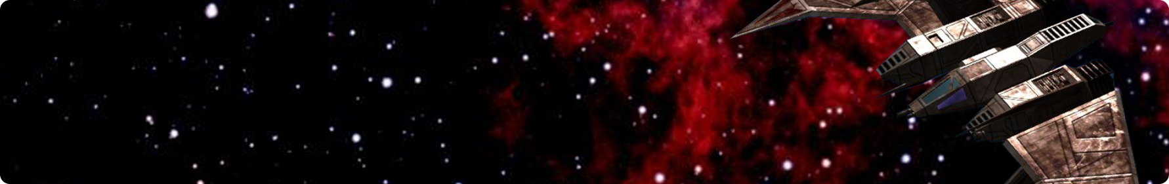
Kilrathi Ships
Pilots
Ships
Cannons
Missiles
Load Simulation
Load Confederation Ships
KFA-983A Darket
KF-65B Dralthi IV
KSF-119B Strakha
KHFB-1066C VokToth
KHFB-1066C VokToth
E:
B:
D/4
Cost:
400
7
T:
5
S:
25
H:
13
Ship Ability: The KHFB-1066C VokToth mounts a computer controlled turret that covers its rear quadrant. This weapon fires independently of the main ship allowing it to target a different target to the pilot themselves. The turret has a gunnery skill of 4, and mounts 2 Meson Guns.
Weapons:
2 – Meson Guns
4 x 2 Missiles
1 x 2 Torpedoes

Slide 20
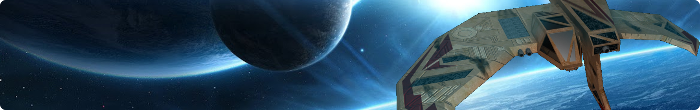
Pilots
Ships
Cannons
Missiles
Load Simulation
Load Confederation Ships
KFA-983A Darket
KF-65B Dralthi IV
KSF-119B Strakha
KHFB-1066C VokToth
KSF-119B Strakha
E:
B:
D/1
Cost:
125
6
T:
4
S:
4
H:
4
Ship Ability: The Strakha mounts of the Kilrathi first production series cloaking devices allowing the ship to vanish from sight and radar at a moments notice. When making a dodge test against guided missiles, treat the pilot skill of the Strakha’s pilot as if it were +2 to it’s normal value.
Weapons:
2 – Laser Canons
2 x 1 Missiles

Slide 21
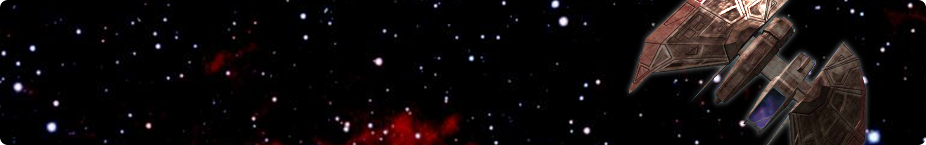
Pilots
Ships
Cannons
Missiles
Load Simulation
Load Confederation Ships
KFA-983A Darket
KF-65B Dralthi IV
KSF-119B Strakha
KHFB-1066C VokToth
KF-65B Dralthi IV
E:
B:
D/6
Cost:
275
8
T:
6
S:
12
H:
8
Ship Ability: [none]
Weapons:
3 – Meson Guns
4 x 1 Missiles

Slide 22
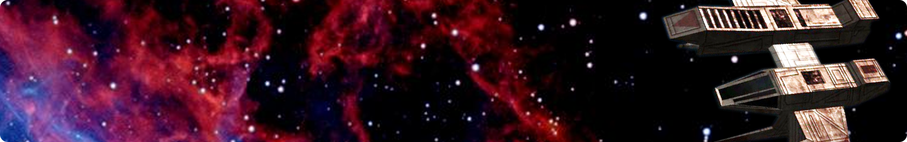
Pilots
Ships
Cannons
Missiles
Load Simulation
Load Confederation Ships
KFA-983A Darket
KF-65B Dralthi IV
KSF-119B Strakha
KHFB-1066C VokToth
KFA-983A Darket
E:
B:
D/3
Cost:
175
7
T:
7
S:
8
H:
2
Ship Ability: The Darket is an exceptionally Nimble design, allowing it to undertake shockingly adept maneuvers in the hands of a skilled pilot. If the pilot of the Darket fails a dodge check, you may re-roll it.
Weapons:
3 – Laser Canons
2 x 1 Missiles

Slide 23
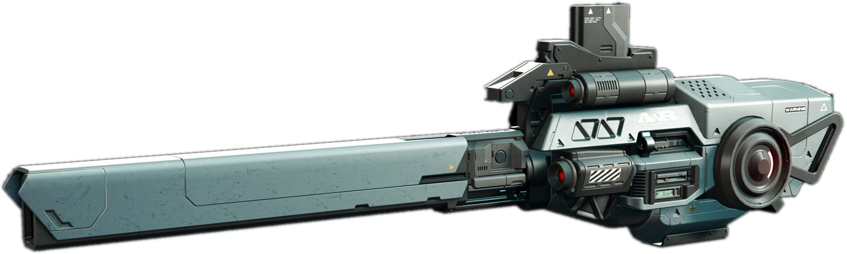
Laser Cannon
Pilots
Ships
Cannons
Missiles
Load Simulation
Laser Cannon
Photon Cannon
Particle Cannon
Tachyon Cannon
Ion Gun
Reaper Cannon
Neutron Gun
Fission Cannon
Mass Driver
Plasma Gun
Plasma Cannon
Plasma Reaper
Meson Gun
Gatling Mass Driver Cannon
Laser Cannon
Dmg:
Rng:
Shots:
1
18”
6
Special:
[none]

Slide 24
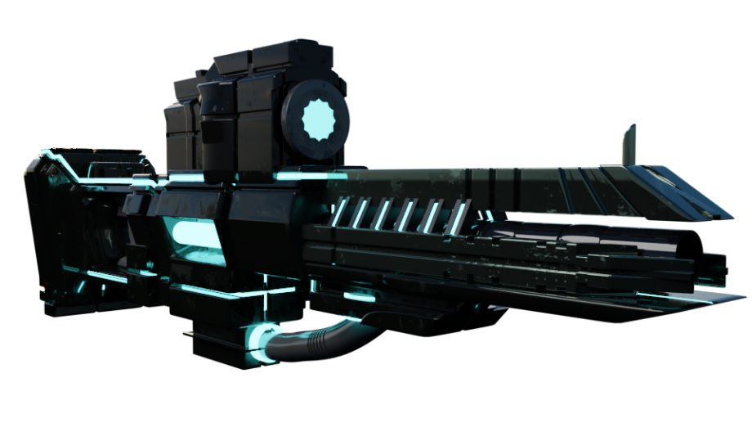
Pilots
Ships
Cannons
Missiles
Load Simulation
Laser Cannon
Photon Cannon
Particle Cannon
Tachyon Cannon
Ion Gun
Reaper Cannon
Neutron Gun
Fission Cannon
Mass Driver
Plasma Gun
Plasma Cannon
Plasma Reaper
Meson Gun
Gatling Mass Driver Cannon
Photon Cannon
Dmg:
Rng:
Shots:
3
14”
2
Special:
[none]

Slide 25
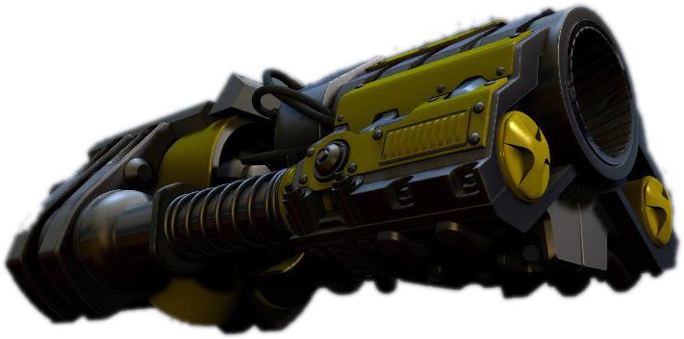
Pilots
Ships
Cannons
Missiles
Load Simulation
Laser Cannon
Photon Cannon
Particle Cannon
Tachyon Cannon
Ion Gun
Reaper Cannon
Neutron Gun
Fission Cannon
Mass Driver
Plasma Gun
Plasma Cannon
Plasma Reaper
Meson Gun
Gatling Mass Driver Cannon
Particle Cannon
Dmg:
Rng:
Shots:
4
10”
1
Special:
[none]

Slide 26
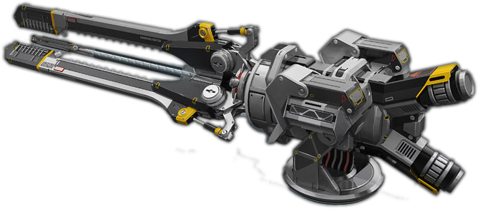
Pilots
Ships
Cannons
Missiles
Load Simulation
Laser Cannon
Photon Cannon
Particle Cannon
Tachyon Cannon
Ion Gun
Reaper Cannon
Neutron Gun
Fission Cannon
Mass Driver
Plasma Gun
Plasma Cannon
Plasma Reaper
Meson Gun
Gatling Mass Driver Cannon
Tachyon Cannon
Dmg:
Rng:
Shots:
4
10”
4
Special:
[none]

Slide 27
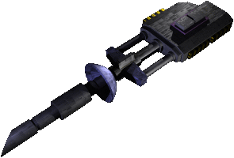
Pilots
Ships
Cannons
Missiles
Load Simulation
Laser Cannon
Photon Cannon
Particle Cannon
Tachyon Cannon
Ion Gun
Reaper Cannon
Neutron Gun
Fission Cannon
Mass Driver
Plasma Gun
Plasma Cannon
Plasma Reaper
Meson Gun
Gatling Mass Driver Cannon
Ion Gun
Dmg:
Rng:
Shots:
4
10”
4
Special:
[none]

Slide 28
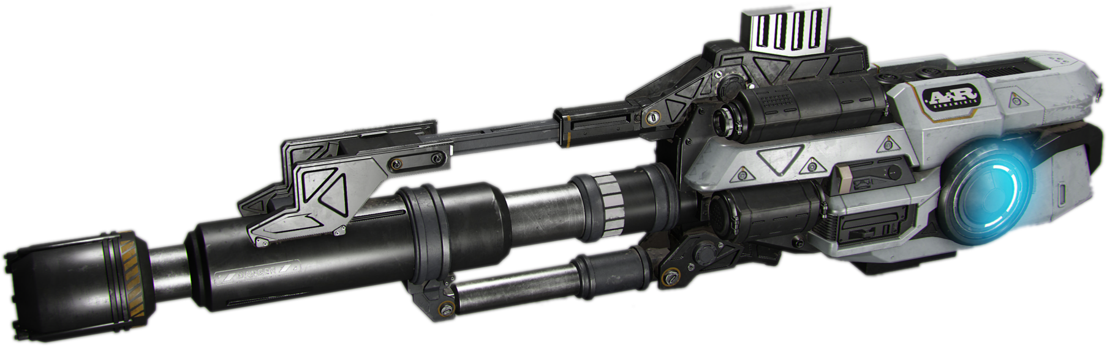
Reaper Gun
Pilots
Ships
Cannons
Missiles
Load Simulation
Laser Cannon
Photon Cannon
Particle Cannon
Tachyon Cannon
Ion Gun
Reaper Cannon
Neutron Gun
Fission Cannon
Mass Driver
Plasma Gun
Plasma Cannon
Plasma Reaper
Meson Gun
Gatling Mass Driver Cannon
Reaper Gun
Dmg:
Rng:
Shots:
6
10”
2
Special:
[none]

Slide 29
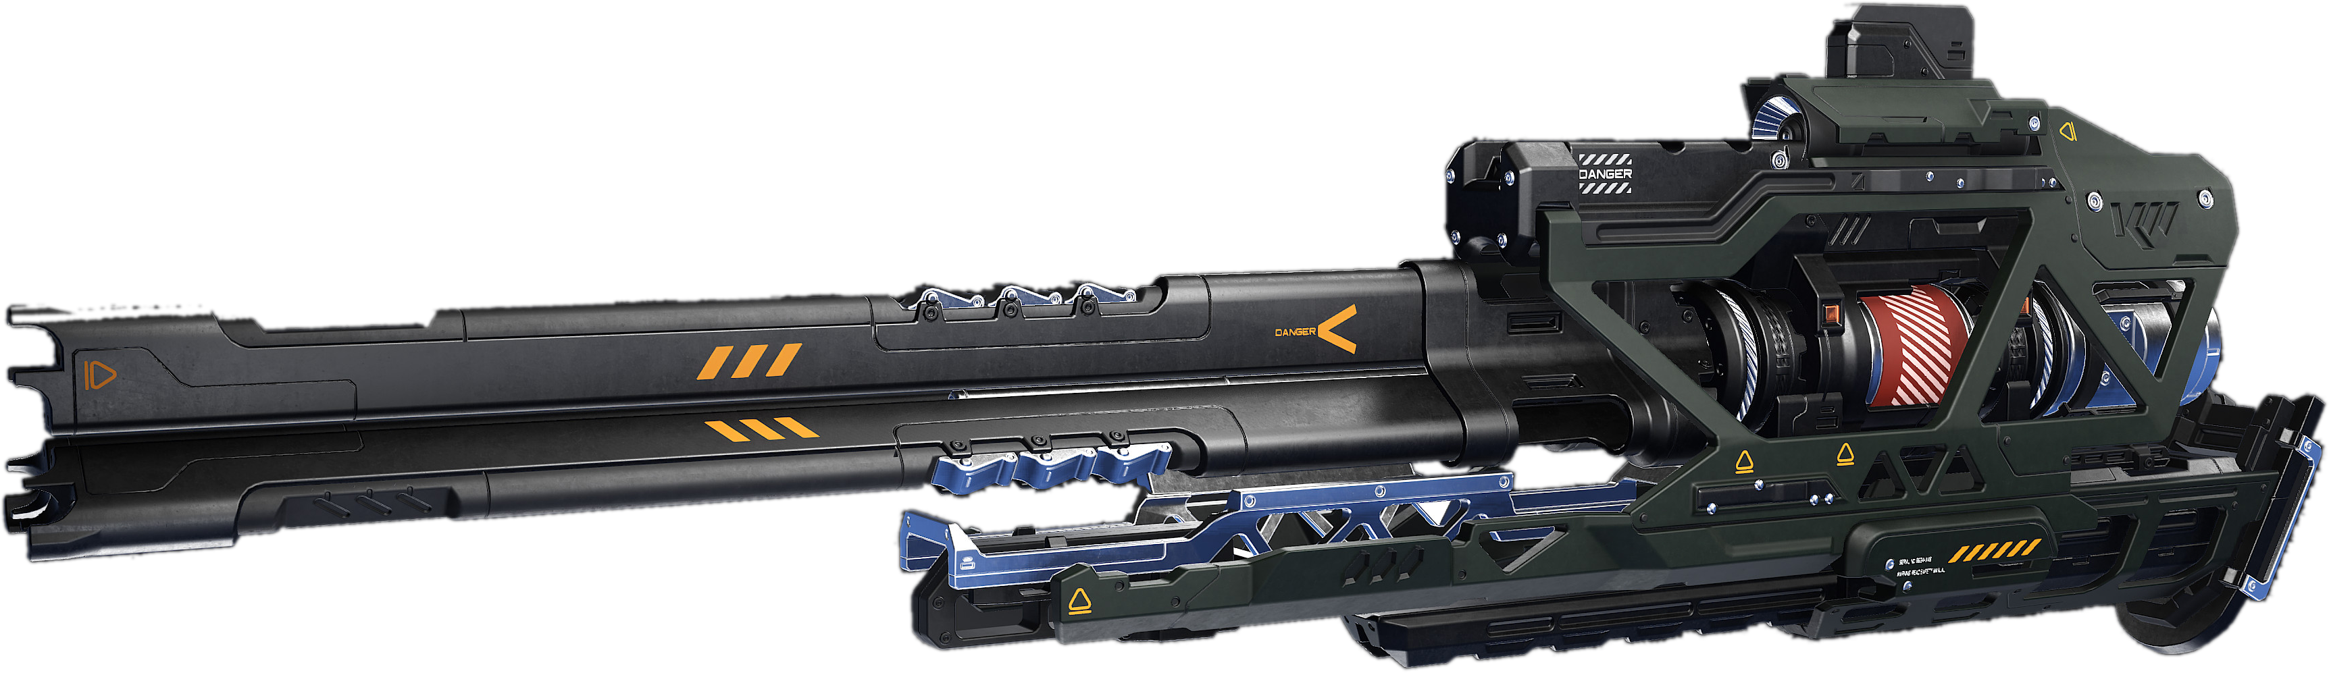
Neutron Gun
Pilots
Ships
Cannons
Missiles
Load Simulation
Laser Cannon
Photon Cannon
Particle Cannon
Tachyon Cannon
Ion Gun
Reaper Cannon
Neutron Gun
Fission Cannon
Mass Driver
Plasma Gun
Plasma Cannon
Plasma Reaper
Meson Gun
Gatling Mass Driver Cannon
Neutron Gun
Dmg:
Rng:
Shots:
7
5”
2
Special:
[none]

Slide 30
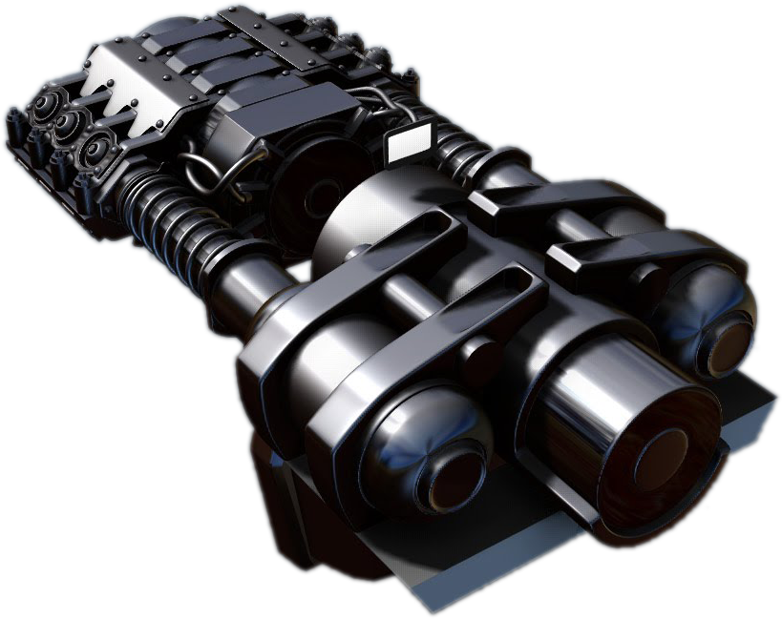
Fission Cannon
Pilots
Ships
Cannons
Missiles
Load Simulation
Laser Cannon
Photon Cannon
Particle Cannon
Tachyon Cannon
Ion Gun
Reaper Cannon
Neutron Gun
Fission Cannon
Mass Driver
Plasma Gun
Plasma Cannon
Plasma Reaper
Meson Gun
Gatling Mass Driver Cannon
Fission Cannon
Dmg:
Rng:
Shots:
8
8”
2
Special:
[none]

Slide 31
Mass Driver
Pilots
Ships
Cannons
Missiles
Load Simulation
Laser Cannon
Photon Cannon
Particle Cannon
Tachyon Cannon
Ion Gun
Reaper Cannon
Neutron Gun
Fission Cannon
Mass Driver
Plasma Gun
Plasma Cannon
Plasma Reaper
Meson Gun
Gatling Mass Driver Cannon
Mass Driver
Dmg:
10
Rng:
6”
Shots:
2
Special:
[none]

Slide 32
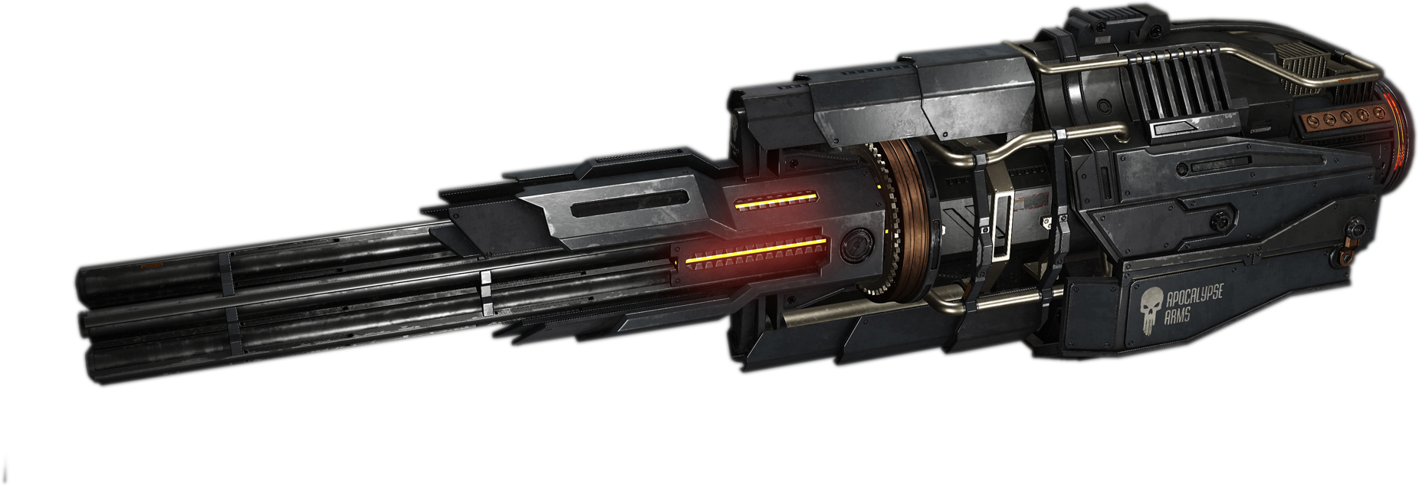
Plasma Gun
Pilots
Ships
Cannons
Missiles
Load Simulation
Laser Cannon
Photon Cannon
Particle Cannon
Tachyon Cannon
Ion Gun
Reaper Cannon
Neutron Gun
Fission Cannon
Mass Driver
Plasma Gun
Plasma Cannon
Plasma Reaper
Meson Gun
Gatling Mass Driver Cannon
Plasma Gun
Dmg:
10
Rng:
6”
Shots:
1
Special:
[none]

Slide 33
Plasma Cannon
Pilots
Ships
Cannons
Missiles
Load Simulation
Laser Cannon
Photon Cannon
Particle Cannon
Tachyon Cannon
Ion Gun
Reaper Cannon
Neutron Gun
Fission Cannon
Mass Driver
Plasma Gun
Plasma Cannon
Plasma Reaper
Meson Gun
Gatling Mass Driver Cannon
Plasma Cannon
Dmg:
30
Rng:
12”
Shots:
1
Special:
[none]

Slide 34
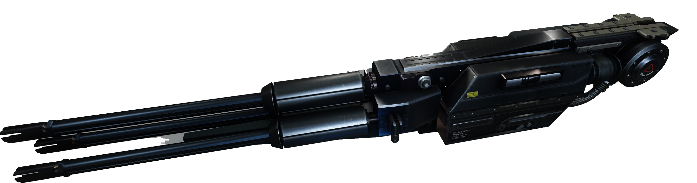
Plasma Reaper
Pilots
Ships
Cannons
Missiles
Load Simulation
Laser Cannon
Photon Cannon
Particle Cannon
Tachyon Cannon
Ion Gun
Reaper Cannon
Neutron Gun
Fission Cannon
Mass Driver
Plasma Gun
Plasma Cannon
Plasma Reaper
Meson Gun
Gatling Mass Driver Cannon
Plasma Reaper
Dmg:
8
Rng:
12”
Shots:
4
Special:
[none]

Slide 35
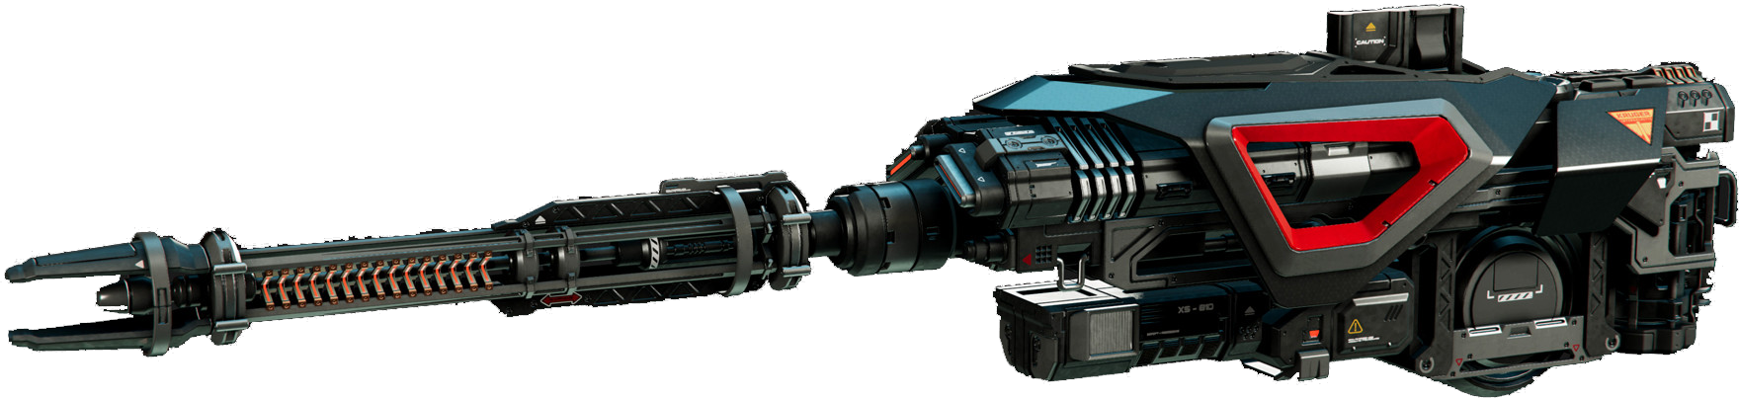
Meson Gun
Pilots
Ships
Missiles
Load Simulation
Laser Cannon
Photon Cannon
Particle Cannon
Tachyon Cannon
Ion Gun
Reaper Cannon
Neutron Gun
Fission Cannon
Mass Driver
Plasma Gun
Plasma Cannon
Plasma Reaper
Meson Gun
Gatling Mass Driver Cannon
Meson Gun
Dmg:
6
Rng:
16”
Shots:
2
Special:
[none]

Slide 36
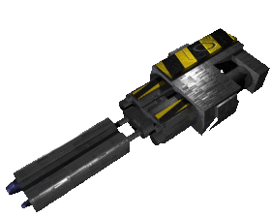
Gatling Mass Driver
Pilots
Ships
Cannons
Missiles
Load Simulation
Laser Cannon
Photon Cannon
Particle Cannon
Tachyon Cannon
Ion Gun
Reaper Cannon
Neutron Gun
Fission Cannon
Mass Driver
Plasma Gun
Plasma Cannon
Plasma Reaper
Meson Gun
Gatling Mass Driver Cannon
Gatling Mass Driver Cannon
Dmg:
10
Rng:
6”
Shots:
6
Special:
[none]

Slide 37
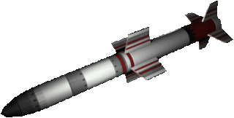
Hunter sight
Pilots
Ships
Cannons
Missiles
Load Simulation
Hunter Sight Missile
Fang F-o-F Missile
Night Sight Missile
Javelin Heat-seeker
Pilum F-o-F Missile
Speculum Image Recon Missile
Paw Dumb Fire
Dart Dumb fire
Hunter Sight Missile
Maneuver
Damage
Track
Lock-on
Duration
Cost
Faction
(3/1)22
45
6
2
3
33
Kilrathi
Criteria:
[Image recon] A potential Target must be of the same model as it's original target and not be a Kilrathi fighter.

Slide 38
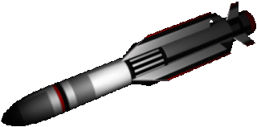
Fang
Pilots
Ships
Cannons
Missiles
Load Simulation
Hunter Sight Missile
Fang F-o-F Missile
Night Sight Missile
Javelin Heat-seeker
Pilum F-o-F Missile
Speculum Image Recon Missile
Paw Dumb Fire
Dart Dumb fire
Fang Friend or Foe Missile
Maneuver
Damage
Track
Lock-on
Duration
Cost
Faction
(3/1)22
35
8
0
3
38
Kilrathi
Criteria:
[Image recon] A potential Target must be of the same model as it's original target and not be a Kilrathi fighter.

Slide 39
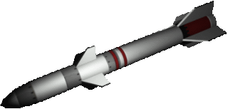
Night Sight
Pilots
Ships
Cannons
Missiles
Load Simulation
Hunter Sight Missile
Fang F-o-F Missile
Night Sight Missile
Javelin Heat-seeker
Pilum F-o-F Missile
Speculum Image Recon Missile
Paw Dumb Fire
Dart Dumb fire
Night Sight Missile
Maneuver
Damage
Track
Lock-on
Duration
Cost
Faction
(2/1)22
45
5
1
4
29
Kilrathi
Criteria:
[Heat Seeker] In order to acquire a potential target, the Javelin must be facing the fighter's rear quadrant.

Slide 40
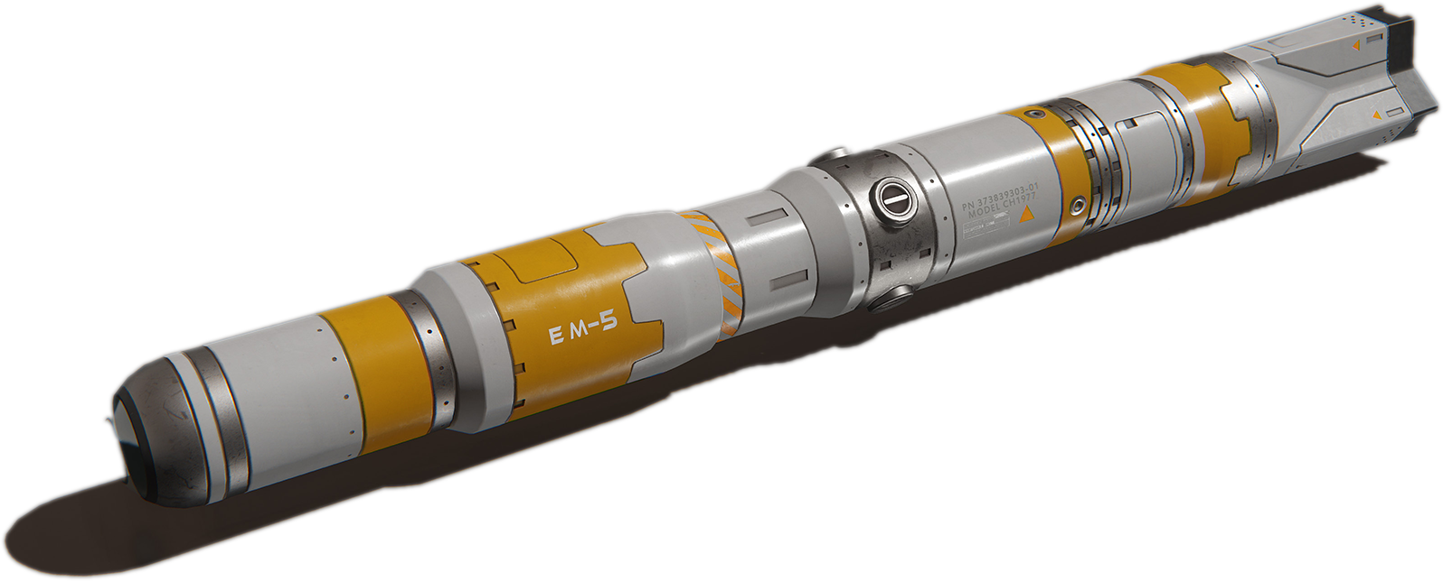
Javelin
Pilots
Ships
Cannons
Missiles
Load Simulation
Hunter Sight Missile
Fang F-o-F Missile
Night Sight Missile
Javelin Heat-seeker
Pilum F-o-F Missile
Speculum Image Recon Missile
Paw Dumb Fire
Dart Dumb fire
Javelin Heat-Seeker Missile
Maneuver
Damage
Track
Lock-on
Duration
Cost
Faction
(2/1)20
50
6
1
4
30
Confederation
Criteria:
[Heat Seeker] In order to acquire a potential target, the Javelin must be facing the fighter's rear quadrant.

Slide 41
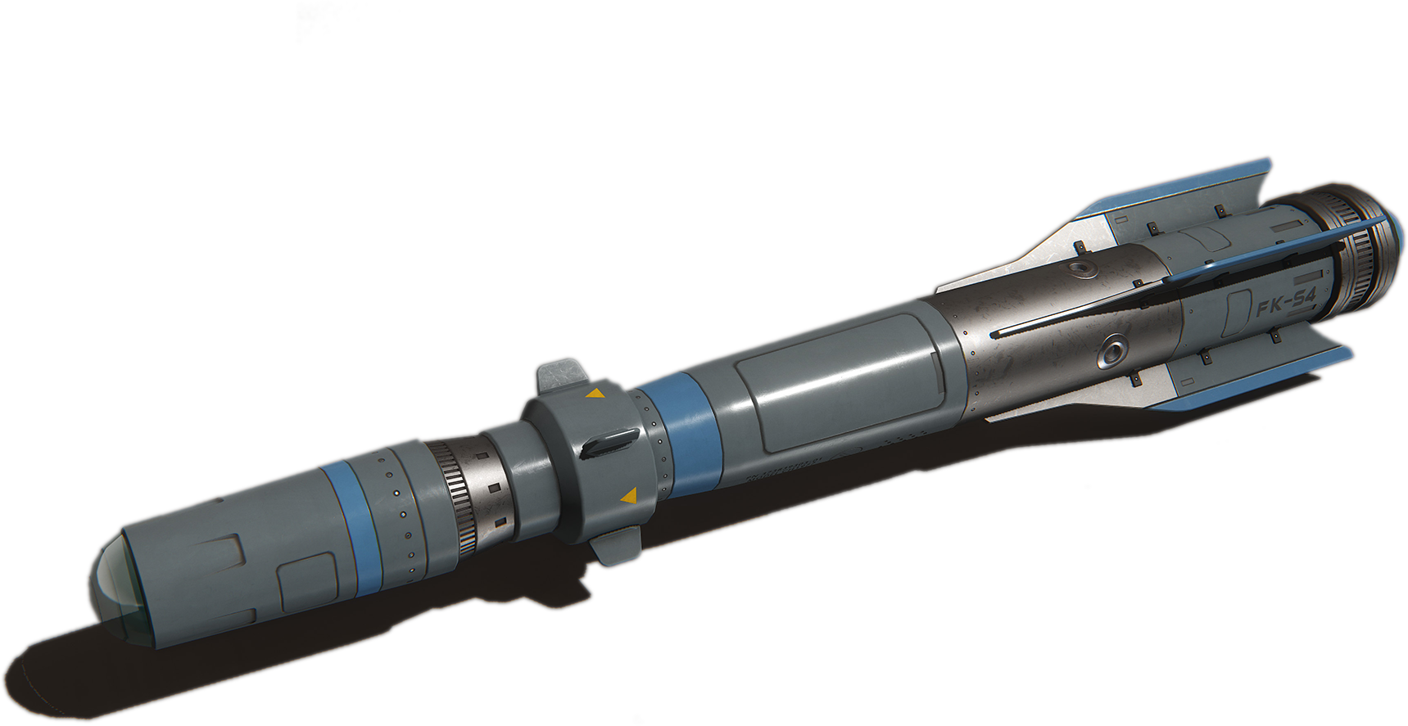
Pilum
Pilots
Ships
Cannons
Missiles
Load Simulation
Hunter Sight Missile
Fang F-o-F Missile
Night Sight Missile
Javelin Heat-seeker
Pilum F-o-F Missile
Speculum Image Recon Missile
Paw Dumb Fire
Dart Dumb fire
Pilum Friend-or-Foe Missile
Maneuver
Damage
Track
Lock-on
Duration
Cost
Faction
(2/1)24
45
6
0
3
33
Confederation
Criteria:
[Comms]A potential target must be either a non-confed fighter or have a 'Disabled communications system" damage result card.

Slide 42
Speculum
Pilots
Ships
Cannons
Missiles
Load Simulation
Hunter Sight Missile
Fang F-o-F Missile
Night Sight Missile
Javelin Heat-seeker
Pilum F-o-F Missile
Speculum Image Recon Missile
Paw Dumb Fire
Dart Dumb fire
Speculum Image Recognition Missile
Maneuver
Damage
Track
Lock-on
Duration
Cost
Faction
(2/1)22
40
8
2
2
29
Confederation
Criteria:
[Image recon] A potential Target must be of the same model as its original target and not be a Confederation fighter.

Slide 43
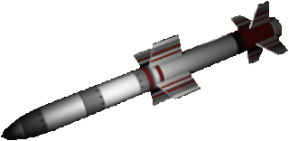
Paw Dumb fire
Pilots
Ships
Cannons
Missiles
Load Simulation
Hunter Sight Missile
Fang F-o-F Missile
Night Sight Missile
Javelin Heat-seeker
Pilum F-o-F Missile
Speculum Image Recon Missile
Paw Dumb Fire
Dart Dumb fire
Paw Dumb fire
Maneuver
Damage
Track
Lock-on
Duration
Cost
Faction
22
26
0
0
1
44
Kilrathi
Criteria:
[Unguided]

Slide 44
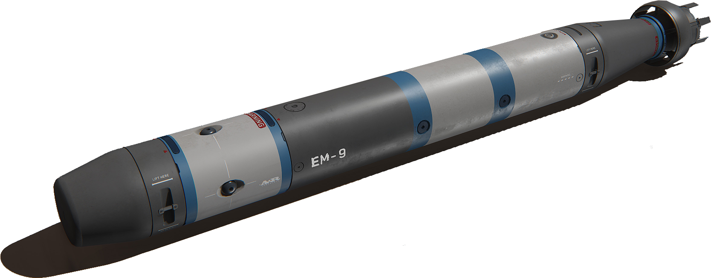
Dart Dumb fire
Pilots
Ships
Cannons
Missiles
Load Simulation
Hunter Sight Missile
Fang F-o-F Missile
Night Sight Missile
Javelin Heat-seeker
Pilum F-o-F Missile
Speculum Image Recon Missile
Paw Dumb Fire
Dart Dumb fire
Dart Dumb Fire
Maneuver
Damage
Track
Lock-on
Duration
Cost
Faction
20
28
0
0
1
40
Confederation
Criteria:
[Unguided]

Slide 45

Load Simulation
Pilots
Ships
Cannons
Missiles
Load Simulation
Create Wing
[Wing Name]
[Enter Wing name]
Add Wing Member
[Select Pilot]
[Select Fighter]
Designation
Commit Wing Member
Create Wing

